Slide 1

IT345 Software Group Project-II
Submitted by:
Dirgh Jani(17IT035)

Slide 2
AMAZON LEX

Slide 3
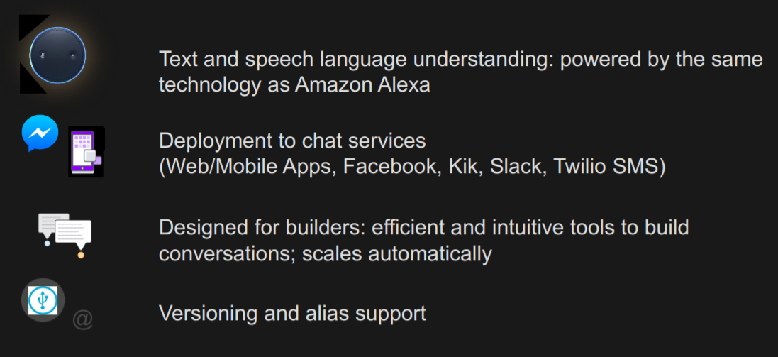
Amazon Lex – Features
Notes:
A version is a numbered snapshot of your work that you can publish for use in different parts of your workflow, such as development, beta deployment, and production.
An alias is a pointer to a specific version of a bot. With an alias, you can easily update the version that your client applications are using. For example, you can point an alias to version 1 of your bot. When you are ready to update the bot, you publish version 2 and change the alias to point to the new version.

Slide 4
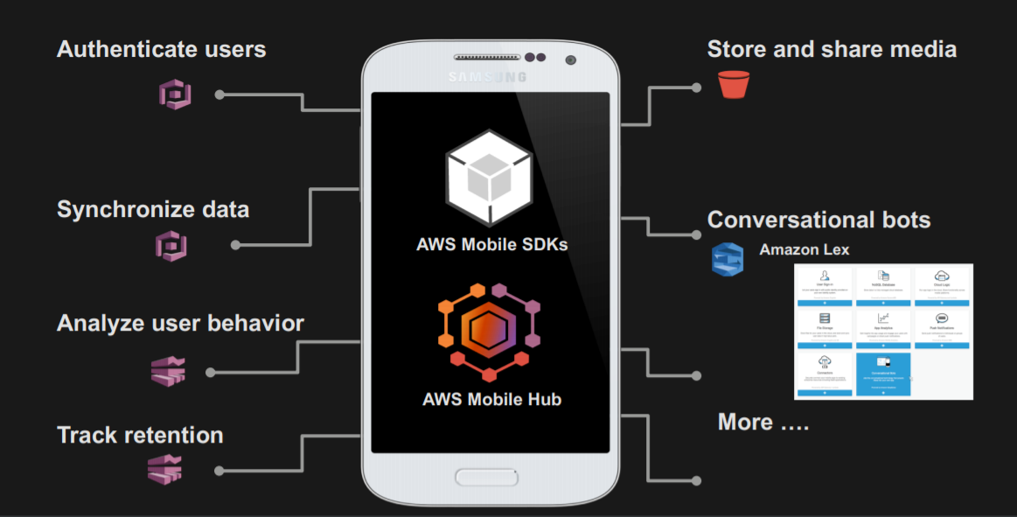
AWS Mobile Hub integration

Slide 5
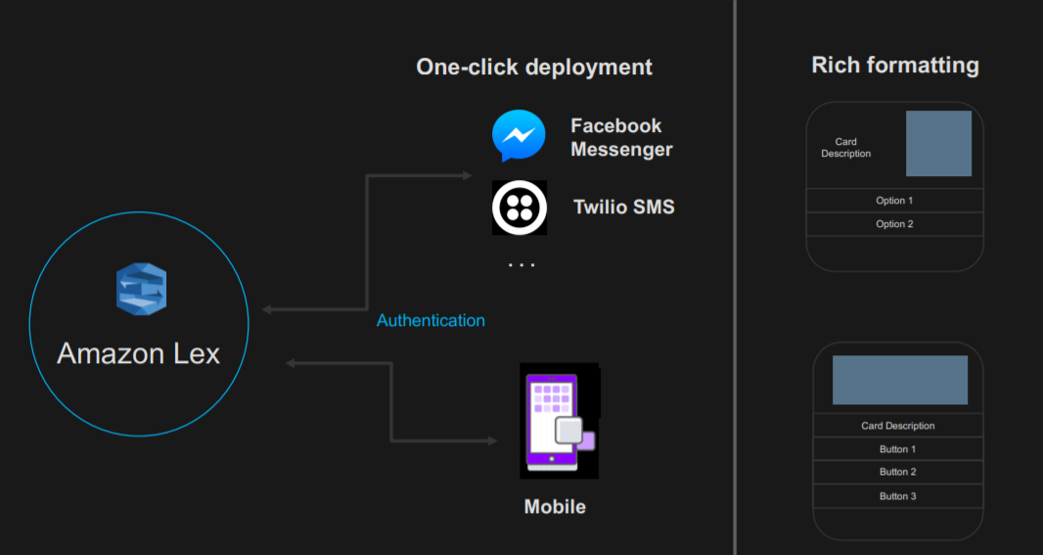
Deployment to chat services

Slide 6
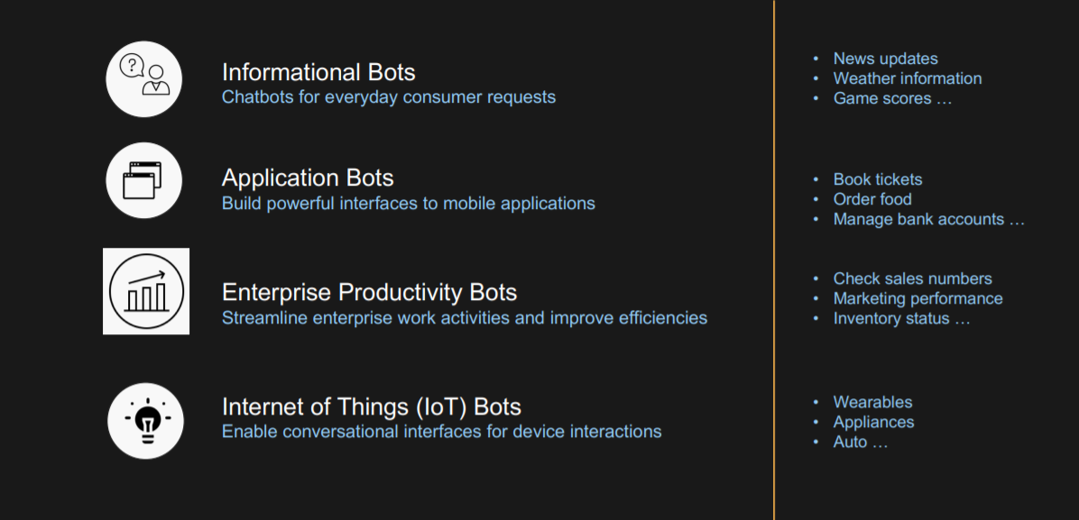
Amazon Lex use cases

Slide 7
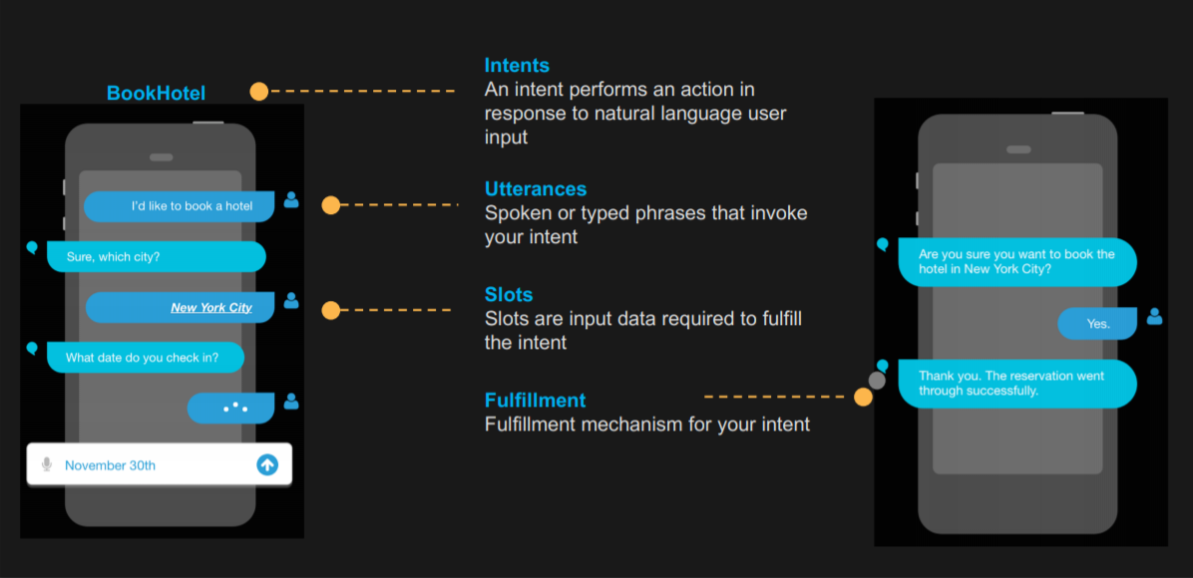
Amazon Lex

Slide 8
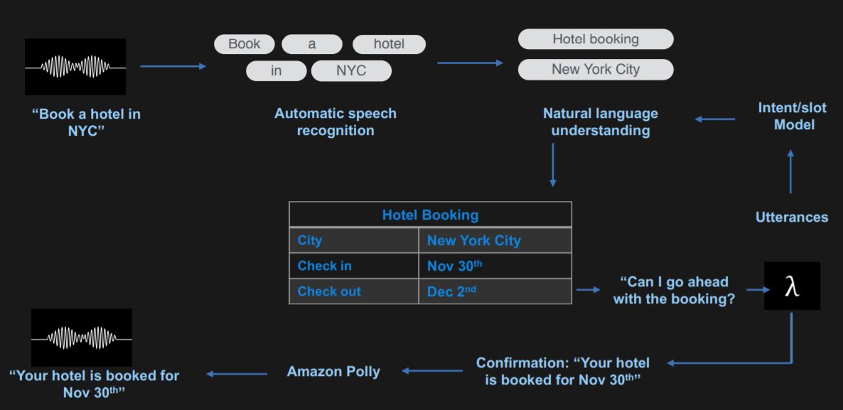
“Book a hotel”

Slide 9
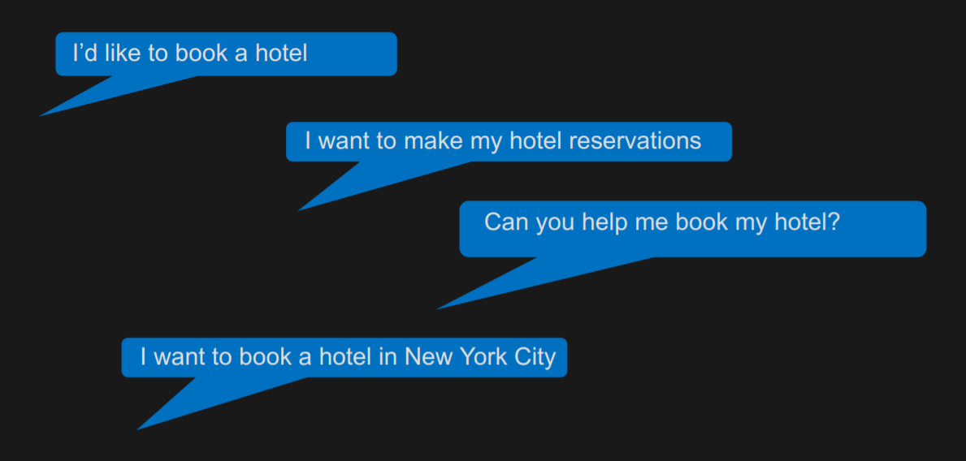
Utterances

Slide 10
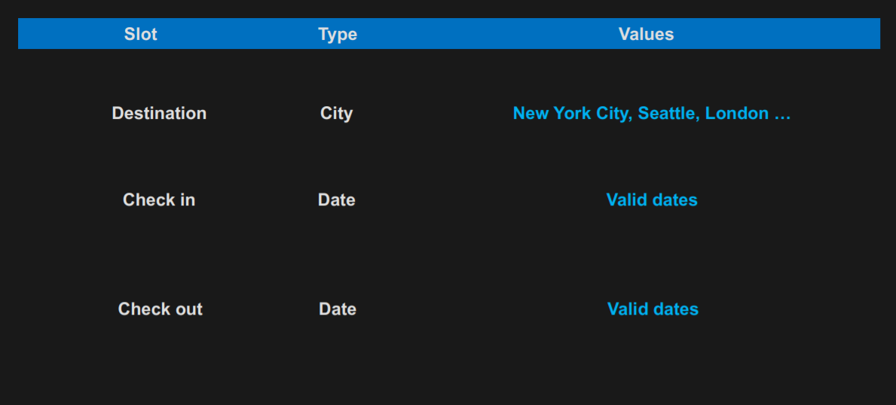
Slots

Slide 11
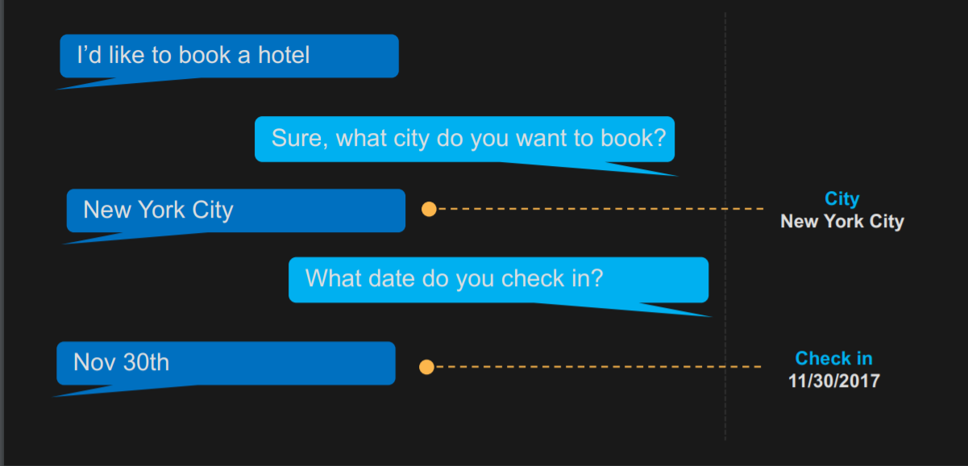
Slot elicitation

Slide 12
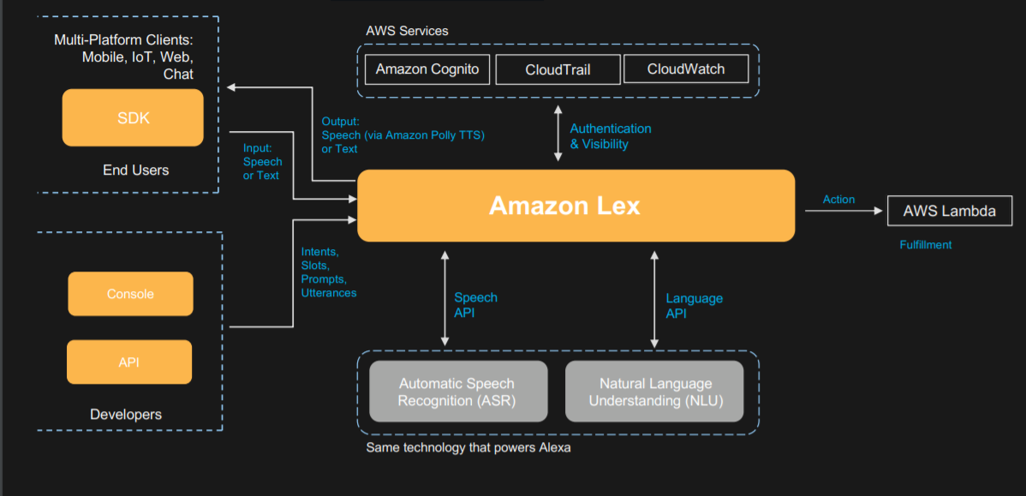
Amazon Lex – technology

Slide 13
Thank YOU

